Slide 1
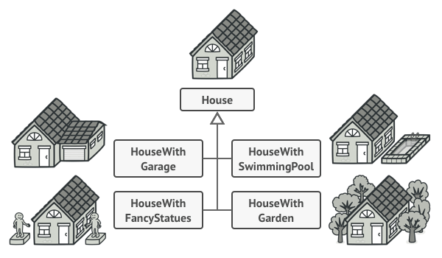
Scenario
Retrieved from:
https://refactoring.guru/design-patterns/builder

Slide 2
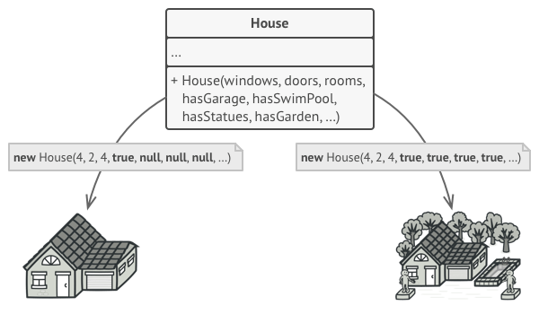
First Approach (Huge initialization & non-practical )
Retrieved from:
https://refactoring.guru/design-patterns/builder

Slide 3
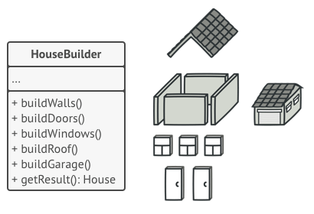
Builder Design Pattern (More practical approach)
Retrieved from:
https://refactoring.guru/design-patterns/builder

Slide 4
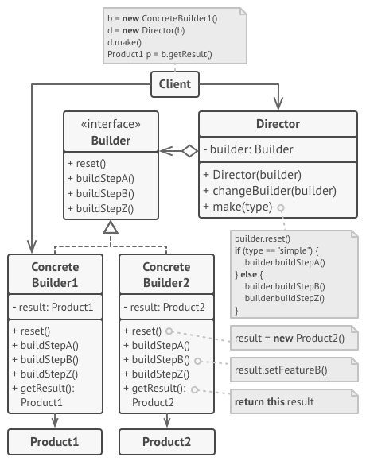
Theoretical Builder Design Pattern
Includes:
-Builder
-Concrete Builders
-Director
Retrieved from:
https://refactoring.guru/design-patterns/builder

